Slide 1
Secure Data Hiding In Images Using Steganography
CAPSTONE PROJECT
Presented By:
Student Name : Arshad Syed
College Name & Department : Thakur College of Engineering & Techmology / Internet of Things

Slide 2
OUTLINE
Problem Statement
Technology used
Wow factor
End users
Result
Conclusion
Git-hub Link
Future scope

Slide 3
Problem Statement
In an era where digital communication is widespread, ensuring the confidentiality of sensitive information is a major challenge. Traditional encryption techniques, while effective, make it evident that a message exists, which can attract unwanted attention from malicious actors. There is a growing need for a system that not only protects the content of a message but also conceals its very existence.
The problem is to develop a solution that securely embeds secret messages within digital images using steganography, combined with encryption for added protection, ensuring safe and hidden communication without arousing suspicion. The system should be simple to use, handle a variety of image formats, and safeguard against data extraction without proper authorization.

Slide 4
Technology used
Programming Language: Python
Libraries:
OpenCV - for image processing
Cryptography (Fernet) – for secure encryption/decryption.
Tkinter – for building GUI interfaces.
NumPy – for efficient image data manipulation.
Concepts:
Least Significant Bit (LSB) Steganography.
Password-based Encryption with PBKDF2.
Tools: Visual Studio Code

Slide 5
Wow factors
Combines Steganography + Encryption for double-layered security.
Password protection ensures that even if the message is extracted, it can't be read without the password.
Supports .png and .jpg images.
User-friendly GUI for both encoding and decoding without using the command line.
Ensures pixel values remain valid with overflow/underflow handling.

Slide 6
End users
Individuals seeking secure and discreet communication.
Journalists or activists needing to protect sensitive information.
Government and military agencies requiring covert data transfer.
Anyone interested in learning or demonstrating steganography.

Slide 7
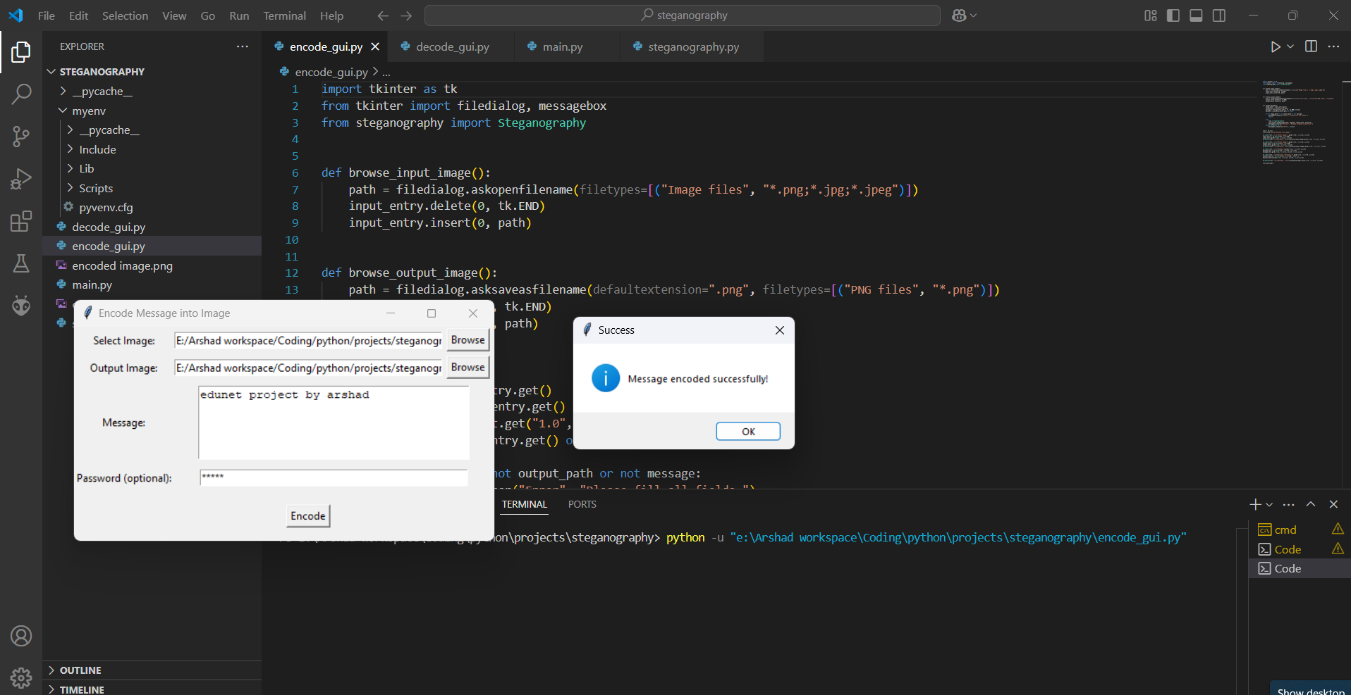
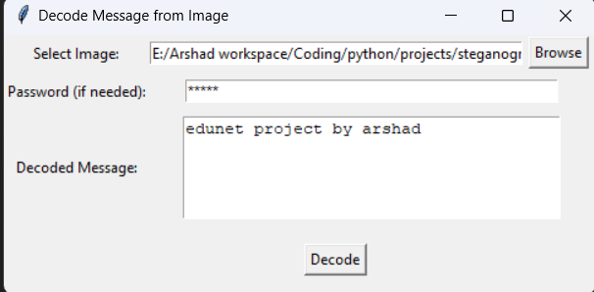
Results

Slide 8
Conclusion
The project demonstrates a robust method of combining data hiding and encryption.
Provides a simple and secure tool for private communication
.Avoids raising suspicion since the message is embedded within a normal-looking image.
Flexible and easy to extend with more features.

Slide 9
GitHub Link
https://github.com/syarshad/Secure-Data-Hiding-In-Images-Using-Steganography/tree/main

Slide 10
Future scope
Support for other file formats like .bmp, .gif, .tiff.
Integration with cloud services for direct upload and sharing.
Adding audio and video steganography.
Implementing advanced encryption algorithms.
Optimization to handle larger messages and high-resolution images.
Mobile application development for Android/iOS.

Slide 11
THANK YOU

